Slide 1

A Tree-Based Framework for Student Performance Forecasting: Early Predictive Modelling and Individualized Behavioral Intervention
www.linkedin.com/in/filotas-theodosiou
www.linkedin.com/in/filotas-theodosiou
Filotas Theodosiou, Yves R. Sagaert, Liam Bossant, Tom Madou
Filotas Theodosiou
Contact Details:
- filotas.theodosiou@vives.be
- www.linkedin.com/in/filotas-theodosiou

Slide 2
Agenda
1
Introduction to Learning Analytics
2
Setting the Learning Environment
3
Forecasting Methodology
4
Behavior Adjustments
5
Discussion
6
Conclusions

Slide 3
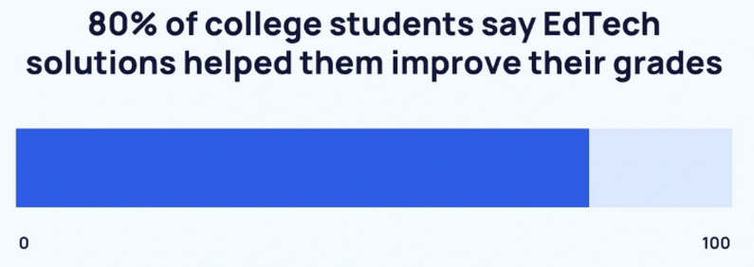

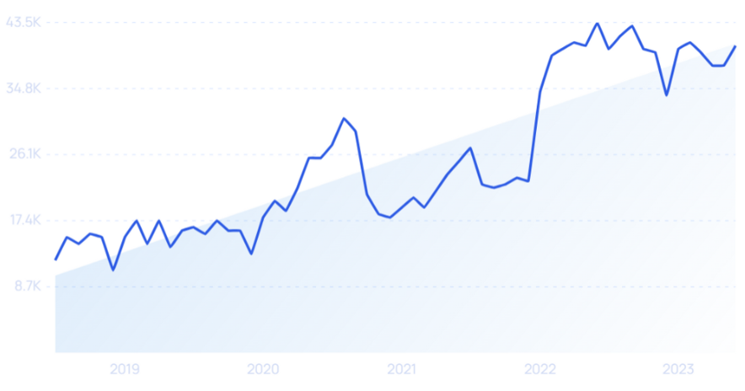

A Brief Introduction to the Context
“The combined use of computer software and educational theory and practice to facilitate learning.”
An explosion in the volume of data available:
Better understanding of the past
More accurate future predictions
Searches for EdTech
Learning Analytics In n a Nutshell
Data Collection
Data Analysis
Actionable Insights
Collect raw data from a learning platform
Apply descriptive and/or predictive modelling
Perform informed decisions based on the gained insights
Robinson, Rhonda; Molenda, Michael; Rezabek, Landra. "Facilitating Learning" (PDF). Association for Educational Communications and Technology. Archived (PDF) from the original on 22 September 2015. Retrieved 18 March 2016.

Slide 4
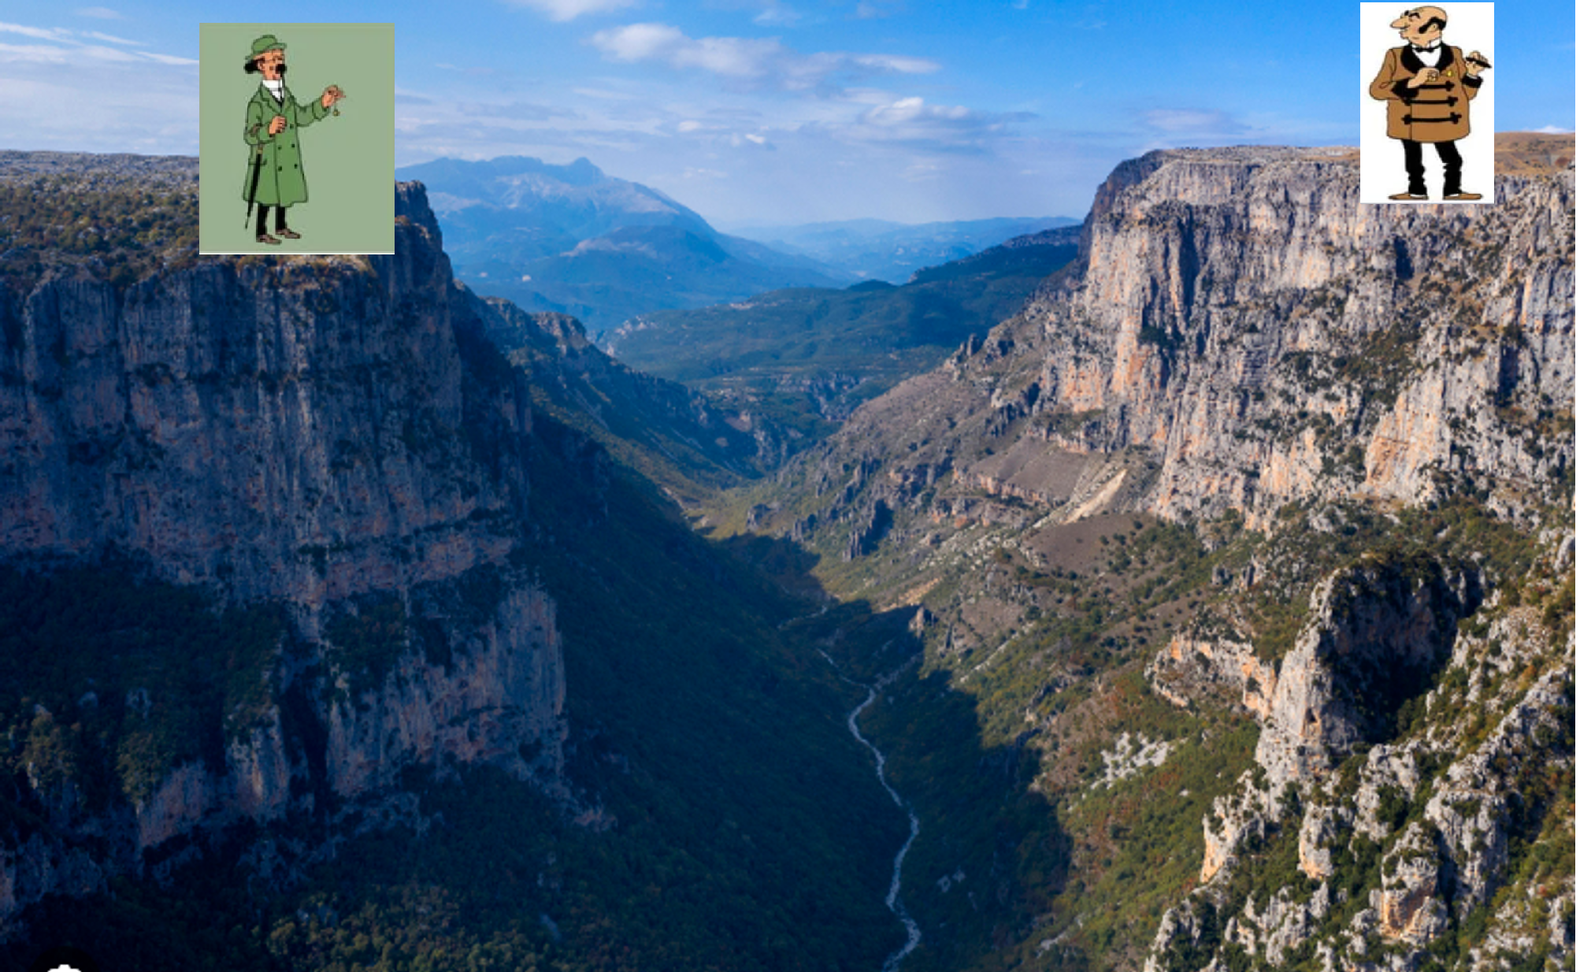
Learning Analytics: Benefits and Pitfalls
Reported Benefits of Learning Analytics:
Reduce the dropout rate
Assist in curricula design
Create a more personalized learning environment
Provide indications of students exam performance
Academia
Industry
The untold part of the story:
Accuracy over early predictions
Forecasting late leaves no time for learning adjustments
2. Teachers lack of confidence in complex predictive models
Limited faith in predictions they cannot interpret
Vikos Canyon in north-western Greece
Cui, Y., Chen, F., Shiri, A.,& Fan, Y. (2019). Predictive analytic models of student success in higher education: A review of methodology. Information and Learning Sciences,120(3/4), 208–227. http://dx.doi.org/10.1108/ILS-10-2018-0104

Slide 5
A Predictive Decision Support Framework📈

Slide 6
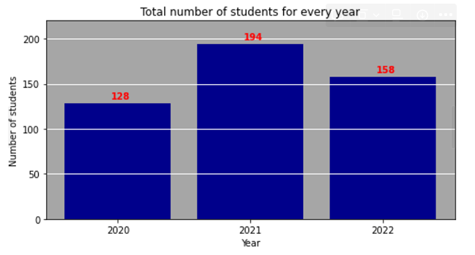


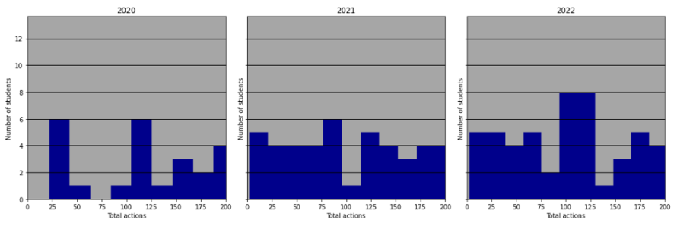



Setting up the Learning Environment
A single 1st year course.
Data collected from 3 academic years
Only the 1st semester is considered
2 years Remote Learning – 1 year Hybrid Learning
Course
Material
Potential issue with Data Shift?
Trial
Exam

Slide 7





An Interpretable Decision Support Framework: Using Predictive Modelling to Boost Students Exam Performance
The Objective of this Work: A Predictive Decision Support Framework 📈
Out aim is:
Predicting Early ⏰
Predicting Accurately 🎯
Predicting Interpretably 💡
The Proposed Framework
Data
Collection
Feature Engineering
Model
Fitting
Predictions’
Explanations
Student
Prompting

Slide 8
Forecasting Methodology: 1. Predicting Early ⏰

Slide 9
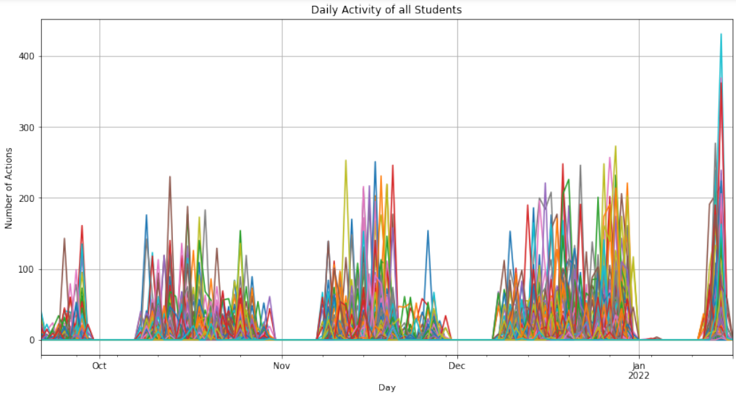
Forecasting Date Selection
Leave Enough Time for Behavioral Adjustment

Slide 10
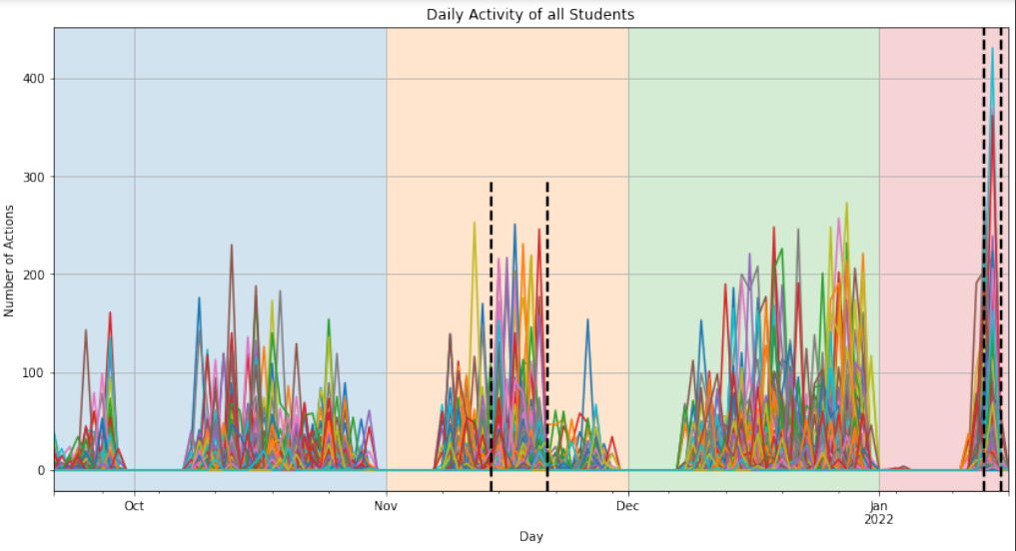
Forecasting Date Selection
Leave Enough Time for Behavioral Adjustment
Weekend before the exams
Early Semester
Mid Semester
Late Semester
Exam
Period
Trial exam
is online

Slide 11
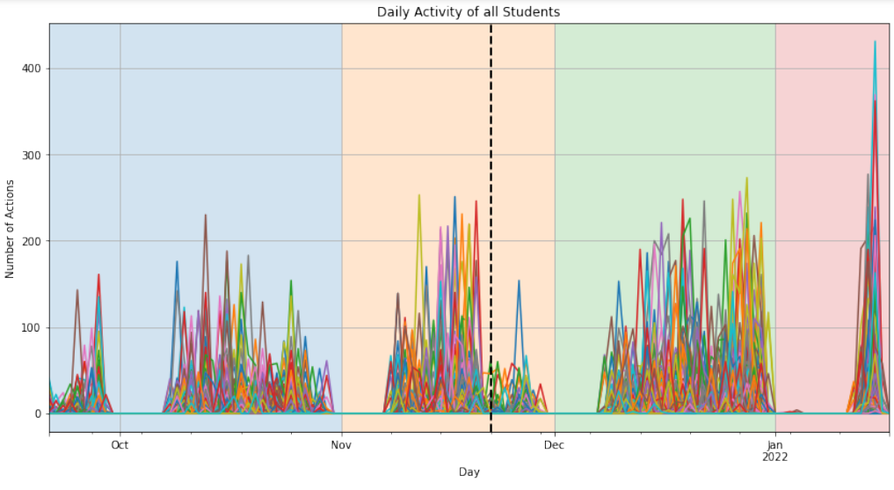
Forecasting Date Selection
Leave Enough Time for Behavioral Adjustment
Our picked
Forecasting date
Most common
Forecasting date

Slide 12
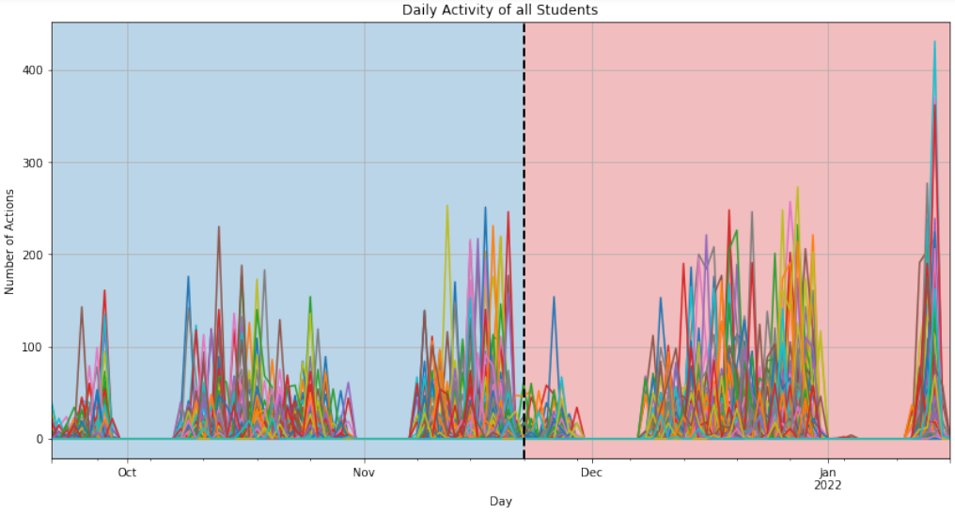
Forecasting Date Selection
Collect Activity data for 55 days
Leave Enough Time for Behavioral Adjustment
Leave 61 days for learning adjustments
Strategy Adjustment
Data Collection

Slide 13
Forecasting Methodology: 2. Predicting Accurately 🎯

Slide 14



Model Selection: The thought process
Not entirely a forecasting task Statistical methods not applicable.
We Rely on Data-Driven Machine Learning Methods.
Which one to pick? 🤷‍♀️
Conflicting literature findings
Two prediction paradigms, one big debate.
Gradient Boosting Decision Trees: A good team of weak members
Different weak learners for diverse features
Informative feature space => more holistic view of the task
Requires detailed description of the problem
Successful Feature Engineering
Proper Hyperparameter tuning
Skewed, longer tail feature distributions
-
Correct Architecture Design
Enough curated Data
Regular and smooth feature distributions
Neural Networks: A problem solver with unique pattern recognition skills
Multiple affine transformations
Finds meaningful representation of the feature space via deduction
Requires enough past experience and good architectural design
McElfresh, Duncan, et al. "When Do Neural Nets Outperform Boosted Trees on Tabular Data?." arXiv preprint arXiv:2305.02997 (2023).

Slide 15
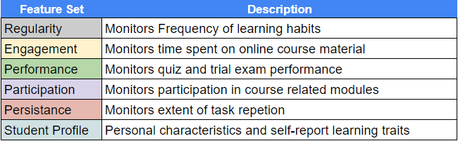
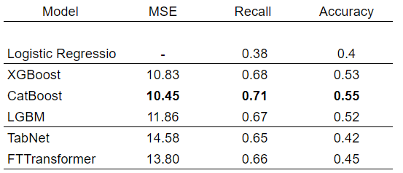
Model Selection: Final Model Selection
Feature Engineering:
We construct multiple and advanced features from raw data.
Model Selection
We conduct an empirical investigation to identify the best model
5-fold cross validation on data of the first two years.
Bin students into 3 classes:
Grade < 8
Grade >8 & Grade < 13
Grade >13
We pick CatBoost
Its not just more accurate!
Handles missing values
Allows the usage of multiple features
Compatible with explainability techniques

Slide 16
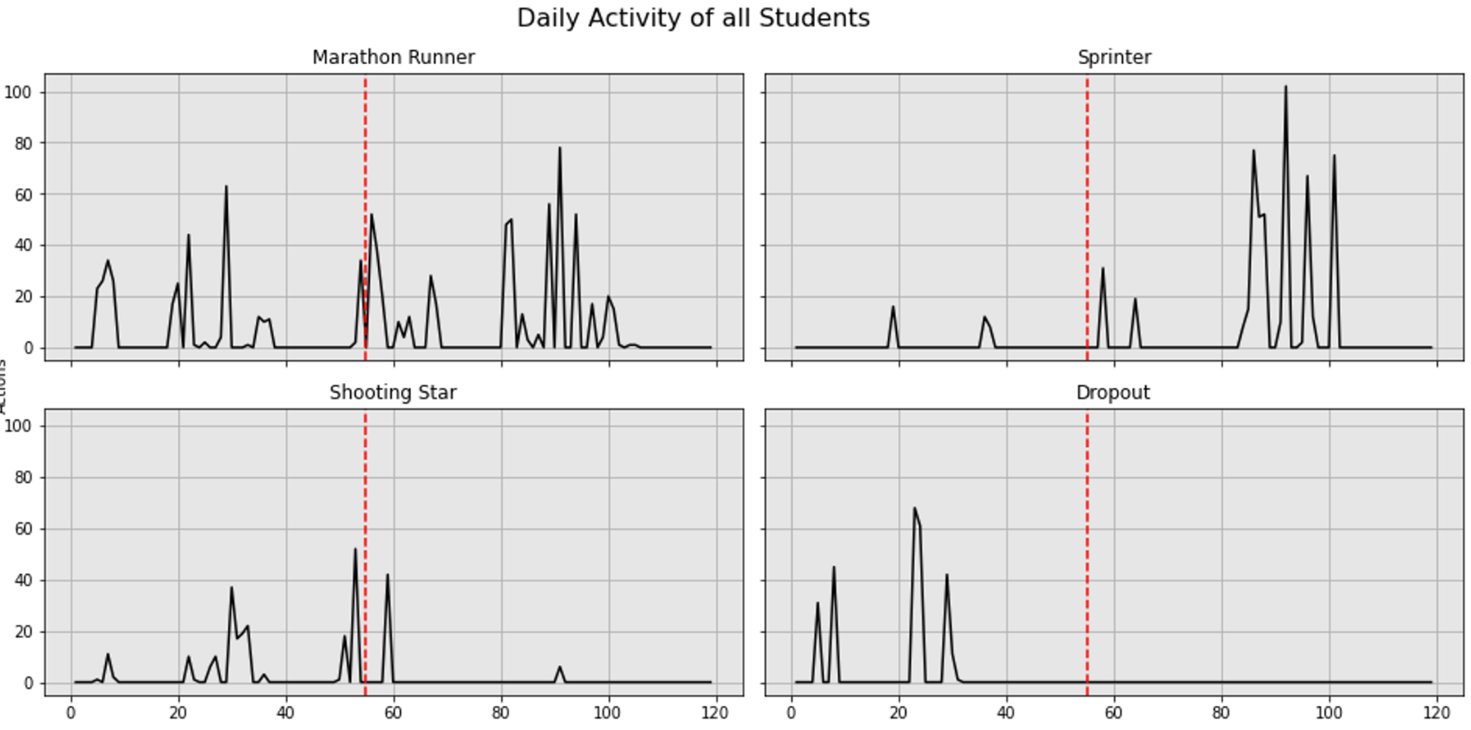
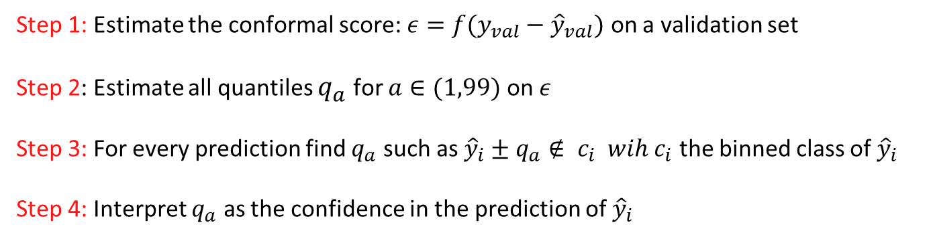
Embracing the Uncertain Future
How much faith can we put in a 1.5-month forecast of student performance?
“Late Sprinters”, “Marathon Runners” and “Sugared-Up Sprinters”
Unpredictable events: (eg break-ups, motivation adjustments)
Pure luck?
Accuracy is just an illusion.
Enter Conformal Predictions (aka Empirical Methods)
Step 1: Estimate the conformal score: $ε=f(y_{val}−{\hat{y}}_{val})$ on a validation set
Step 2: Estimate all quantiles $q_{a}$ for $a∈(1,99)$ on $ε$
Step 3: For every prediction find $q_{a}$ such as ${\hat{y}}_{i}±q_{a}∉ c_{i} wih c_{i}$ the binned class of ${\hat{y}}_{i}$
Step 4: Interpret $q_{a}$ as the confidence in the prediction of ${\hat{y}}_{i}$

Slide 17
Forecasting Methodology: 2. Predicting Interpretably💡

Slide 18
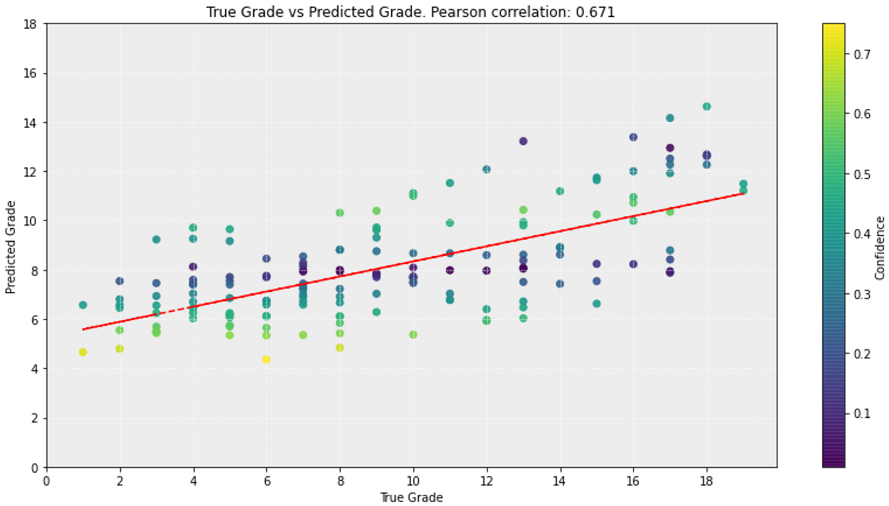

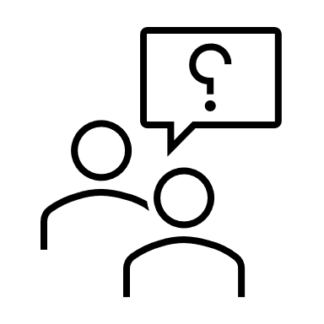
Explain your predictions
SHapley Additive exPlanations (SHAP) Values:
Inspired by game theory
Quantify the contribution of each feature to a single prediction
Consider collaboration among features
A weighted sum of the marginal contribution of feature to a local prediction
SHAP values measure feature contributions to predictions, not true grades
Why SHAP Values you ask.
Identify which features contributed negatively to a student’s predictions
Convert these features into areas of potential improvement for each student
Lundberg, Scott M., and Su-In Lee. "A unified approach to interpreting model predictions." Advances in neural information processing systems 30 (2017).

Slide 19
Some Explanations…
High Variance on Quiz Grades
Low Sum of Max Grades on Quizzes
Student A:
Predictions: 11.9 | Confidence = 51%
Student B:
Predictions: 9.35 | Confidence = 82%
Bad Scores on Trial Exam
Low Minimum Score on a Quiz
Student C:
Predictions: 10.69 | Confidence = 67%
Low Forum Activity

Slide 20
Behavioral Adjustment

Slide 21
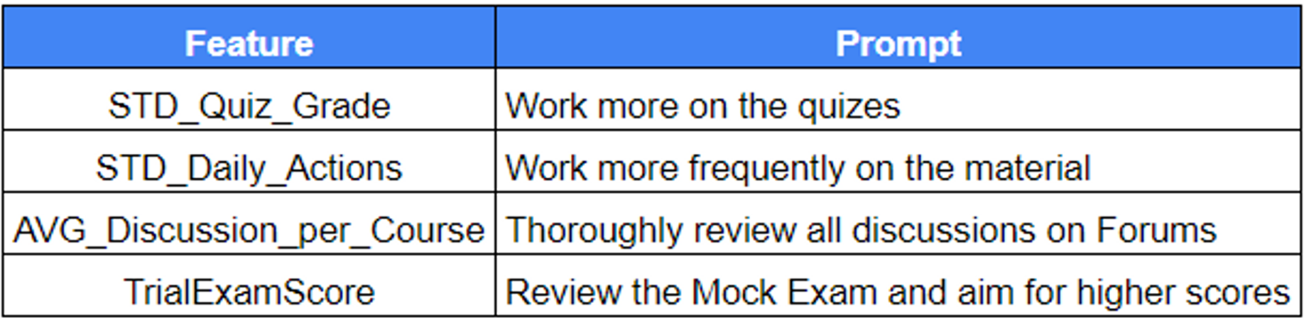
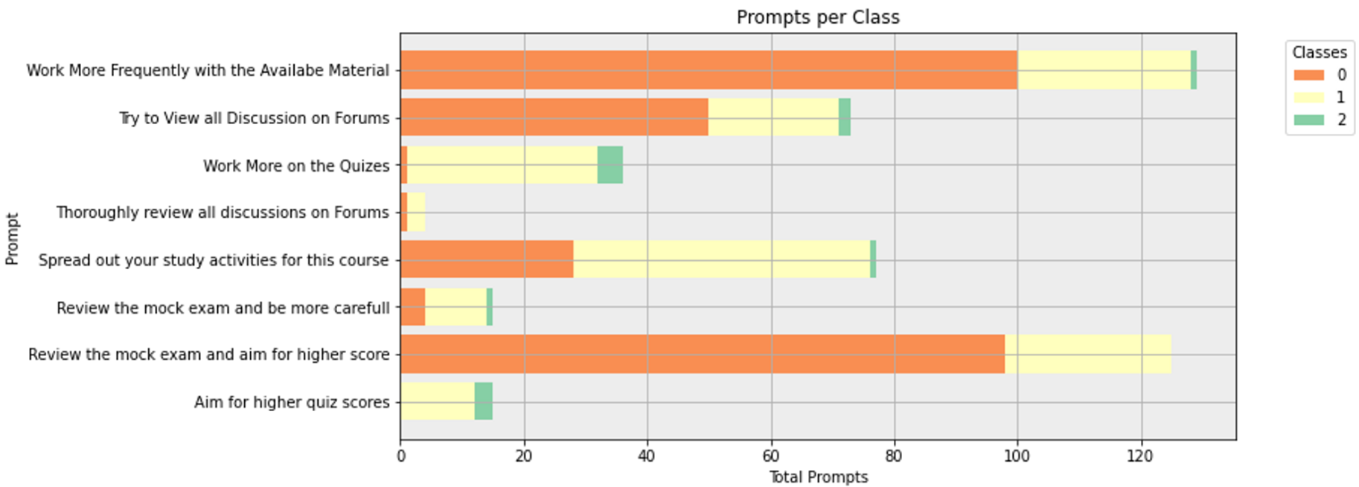
Turning Explanations into Prompts
Turn explanations into unique prompts:
Step 1: Match each feature with an appropriate prompt.
Step 2: Identify the 2 most negatively influencing features for every student
Step 3: Inform teacher for the prediction results and the prompt candidates
Step 4: Email students with the unique prompts.
Prompt Examples
Engagement
Persistence
Regularity
Performance

Slide 22
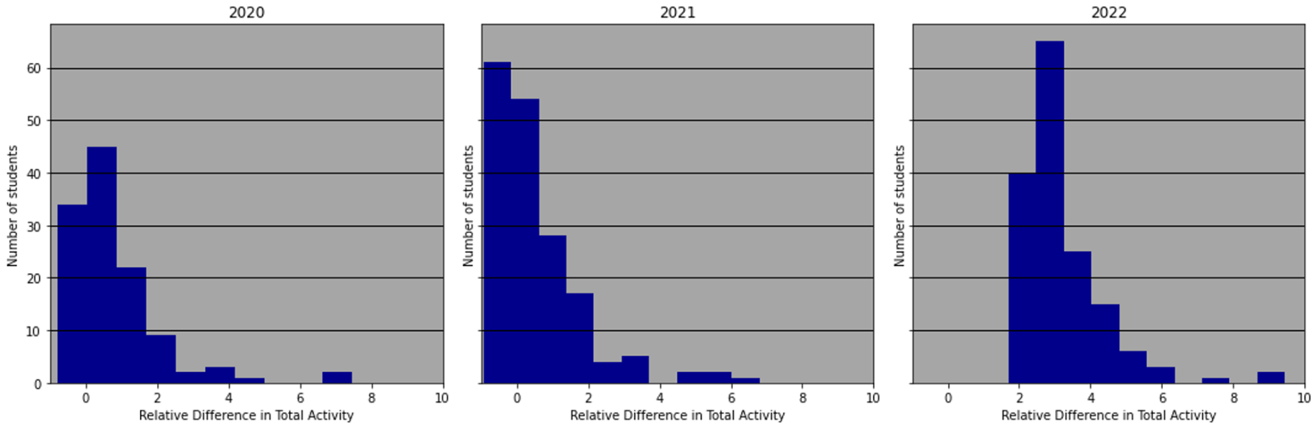
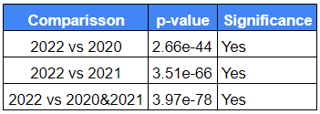
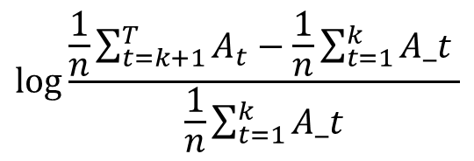
Did Prompting Worked? Some Initial Results
$$log⁡\frac{\frac{1}{n}\sum_{t=k+1}^{T}{A_{t}−\frac{1}{n}\sum_{t=1}^{k}{A_t}} }{\frac{1}{n}\sum_{t=1}^{k}{A_t}}$$
In simple Terms:
How many more daily actions (on average) a student made after prompting
We define the Relative Difference in Total Activity as:
We conduct an ANOVA significance test

Slide 23
Things to Discuss
We know prompting lead to learning adjustments.
Did it result in improvements in the exam performance?
We are investigating..
2. Can a fine tuned Large Language Model (LLM) become a great individual prompter?
Future Work: A personalized prompting assistant for every student
Fine tune a LLM using Reinforcement Learning with Human Feedback (RLHF)
Provide it with collected & predicted information for every student
Collaborate with students.

Slide 24
To summarize:
We propose a Predictive Decision Support Framework for Learning Management Systems
We achieve:
Early Predictions
Accurate Predictions
Transparent Predictions
Based on these predictions:
We implement specialized prompting
Initial results show positive learning behavior adjustments
In the Future:
We look to improve our prompting strategy using specialized AI agents for every student

Slide 25
The end ☺
Questions?
Filotas Theodosiou
Contact Details:
- filotas.Theodosiou@vives.be
- www.linkedin.com/in/filotas-theodosiou

